Slide 1
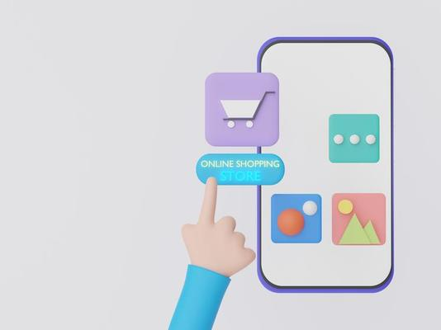
Team 10 – Instacart Market Basket Analysis and Recommendation System using Azure Cosmos DB Multi Model Database
1. Shashank Dongre - NUID 002747740
2. Ashwini Khedkar - NUID 002738717
3. Keerthanaa Kannan - NUID 001593845
4. Samradni Pathari - NUID 002655149

Slide 2
Introduction:
Instacart, a popular online groceries delivery service, is operational in 5500+ cities in USA and Canada with 600+ partners serving 9.6 million users, as of 2023.
In this project, we propose the development of an Instacart Market Basket Analysis and Recommendation System using a globally distributed, Multi-model NoSQL Database System Azure Cosmos DB.
This system will analyze customer purchase history and recommend products based on their purchase history and suggest similar preferences.
Here, we are aiming to leverage the multi-model nature of Azure Cosmos DB and explore its graph functionalities to gain insights on relationships between products, and their location.

Slide 3

Objectives:
Representing orders and prior orders as a document database to improve recommendation accuracy.
Using a document-graph hybrid model to analyse and visualize relationships between customers and the products they ordered, visualize the location of products that are more likely to be reordered.
Analyzing the details, frequency, and customer preferences of the most frequently ordered products.
The goal of the project is to understand, design, develop, and implement ETL pipelines to understand the internal working of the data workflows.
Understand and utilize a host of services provided by the Azure platform and emulate its functioning in a test environment.

Slide 4
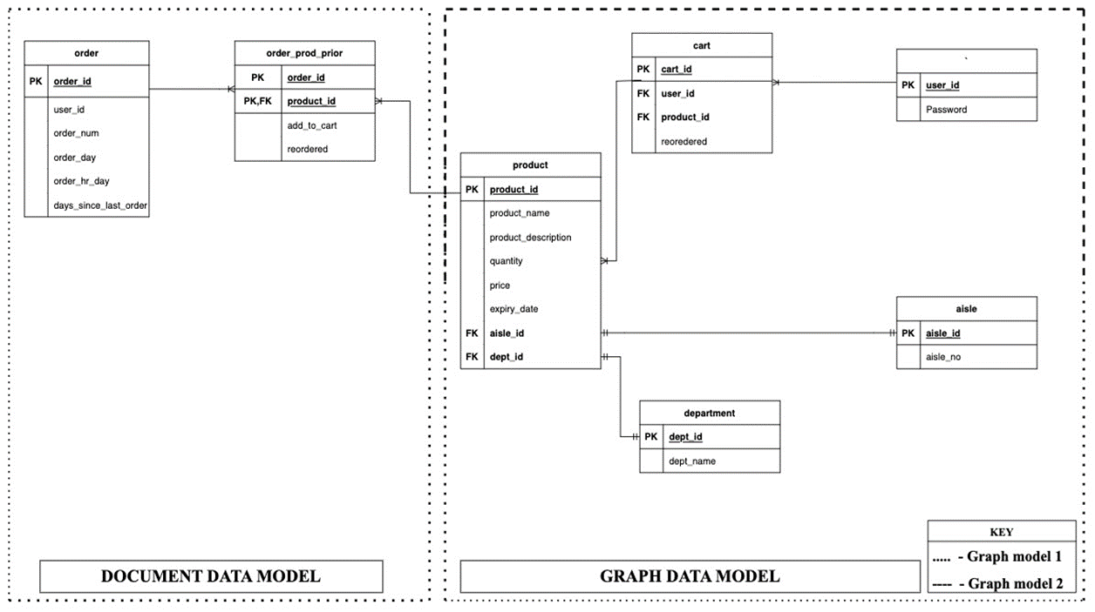
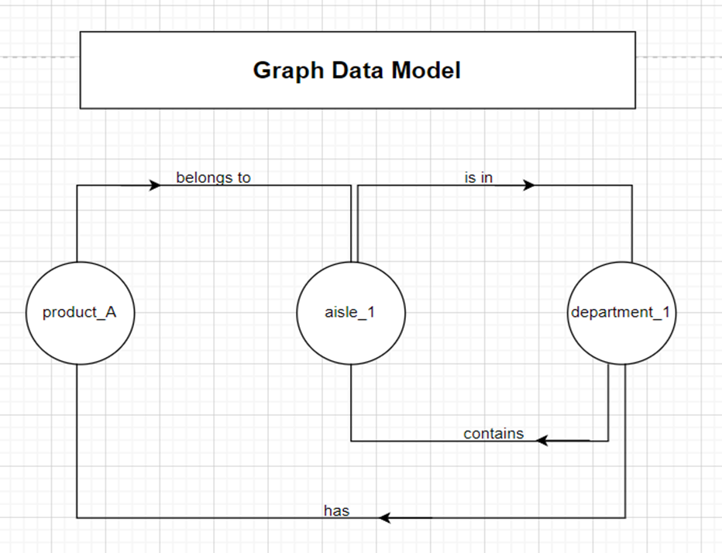
Data Models:

Slide 5

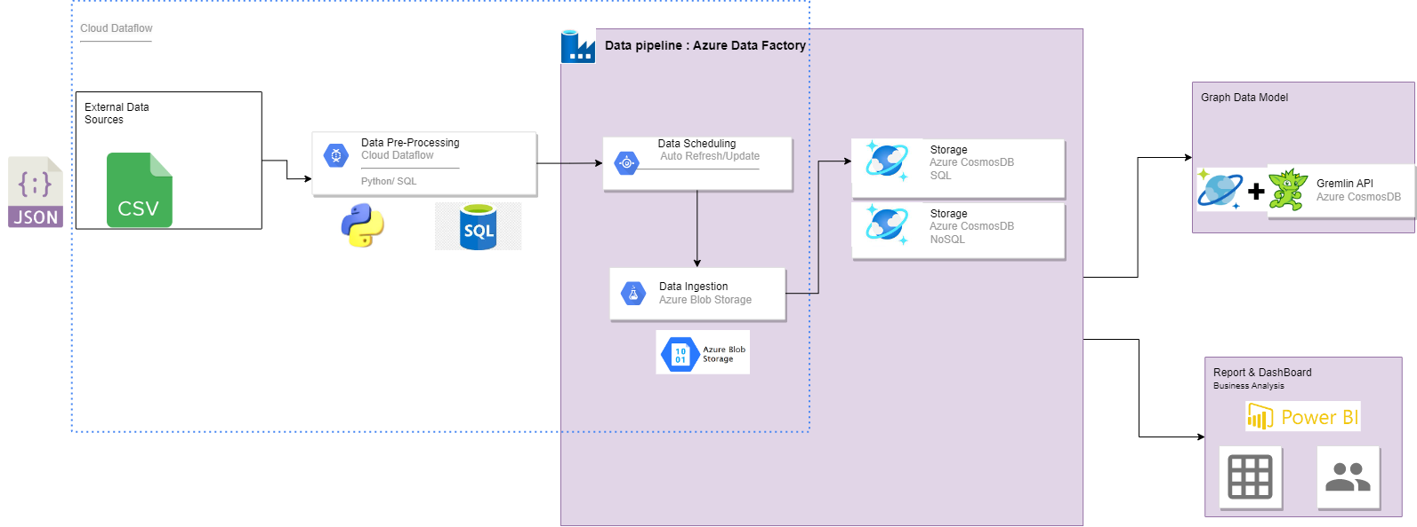
Architecture Diagram:
Extract Transform Load Visualizations

Slide 6
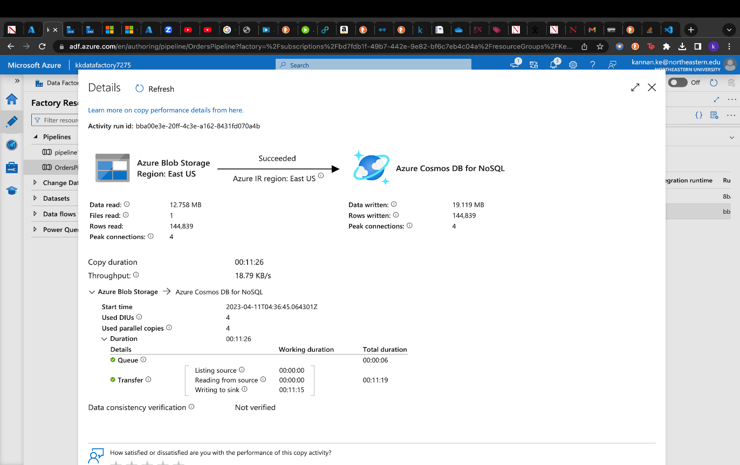
Document Data Model Implementation:
Document data model for upload and copy of the document data which contains orders and order_products_sample from Azure blob storage to Azure Cosmos DB.
Graph data model for upload and copy of the Graph data which contains Aisles, Department, and Product data from Azure blob storage to Azure Cosmos DB.
OrderID is selected as partition key, dividing the dataset in countless partitions for faster query performance.

Slide 7
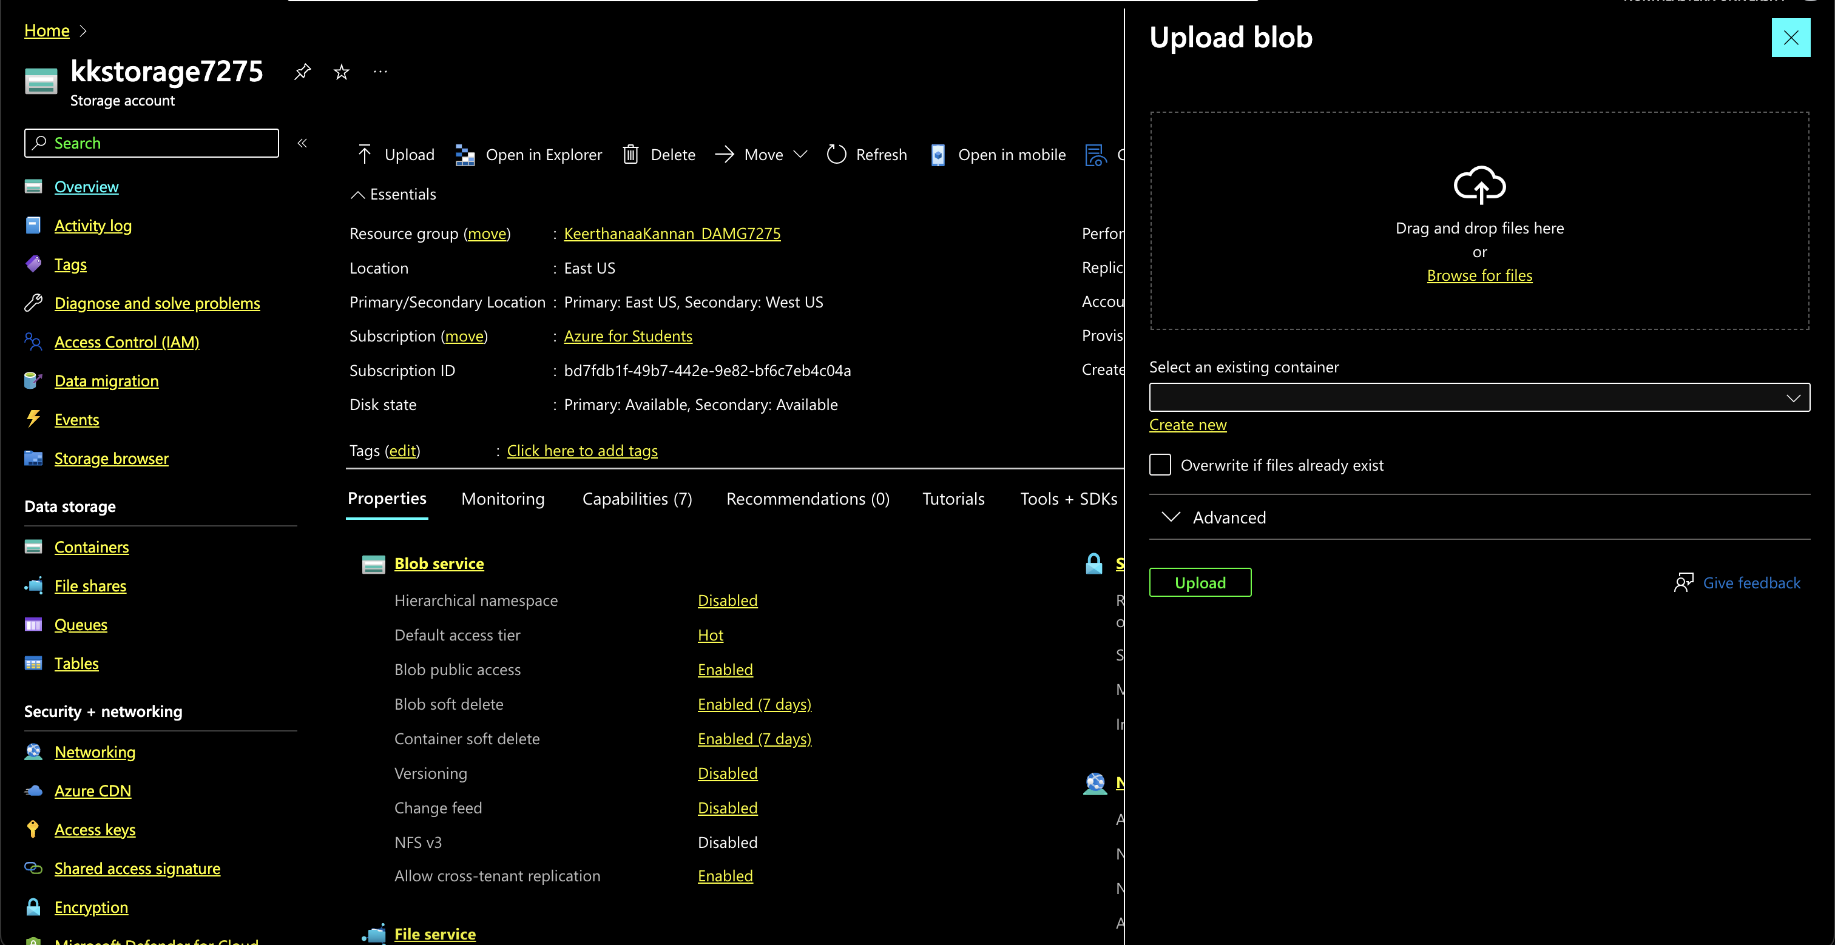
AZURE BLOB STORAGE

Slide 8
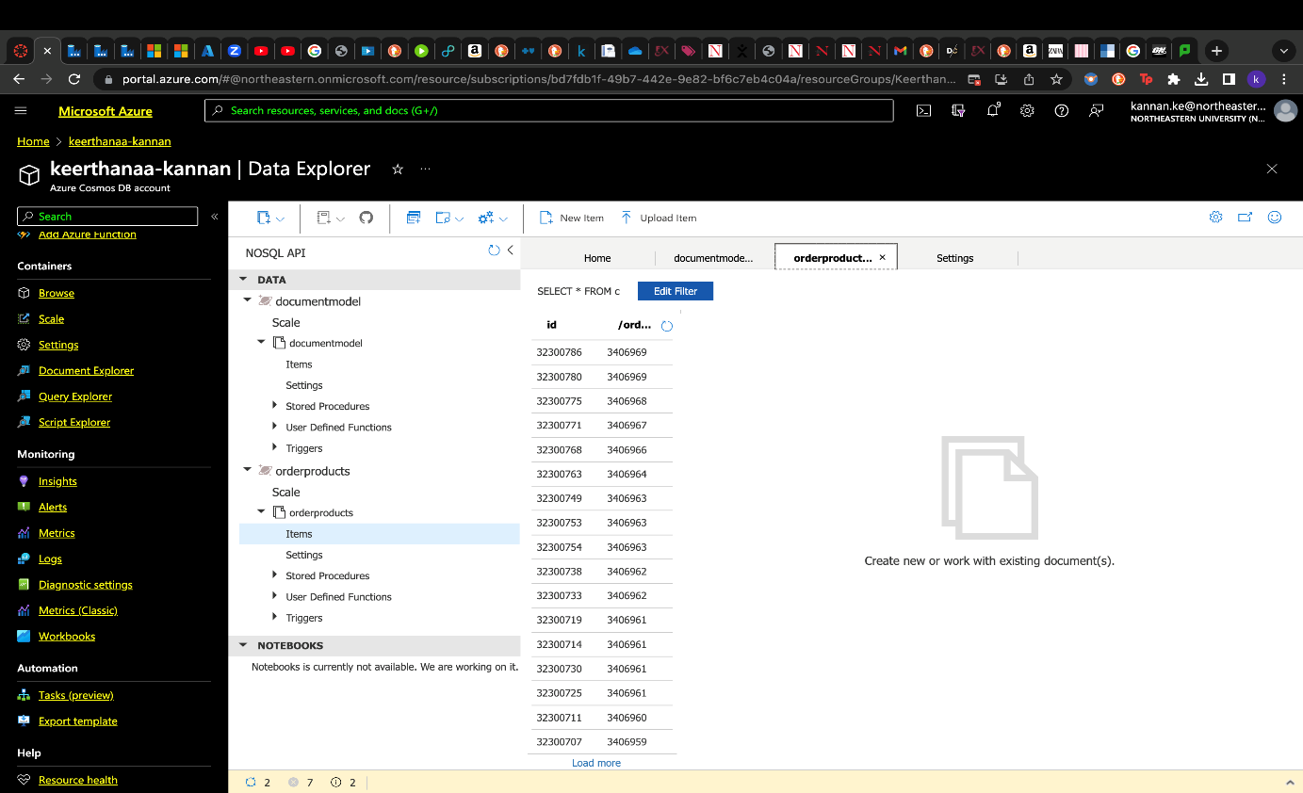
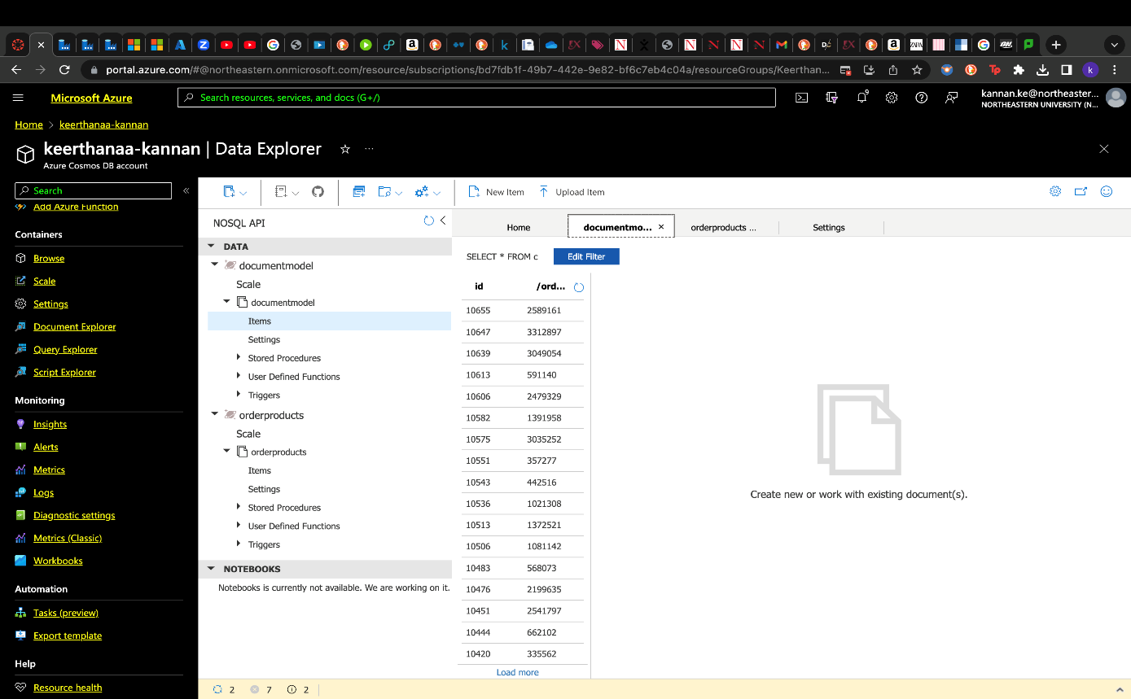
Document Data Model Implementation:

Slide 9
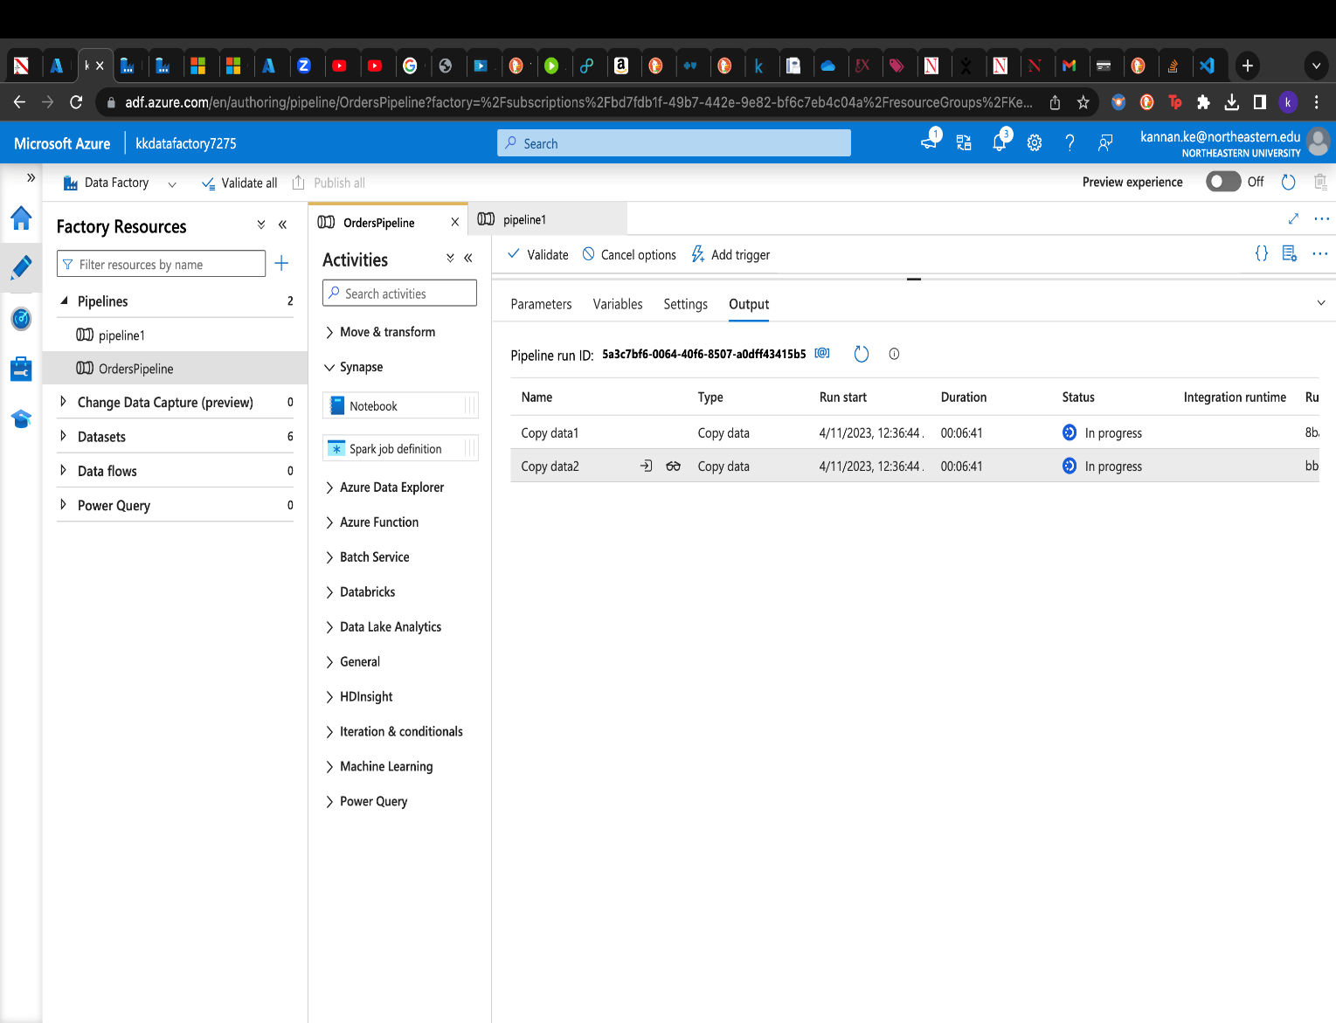
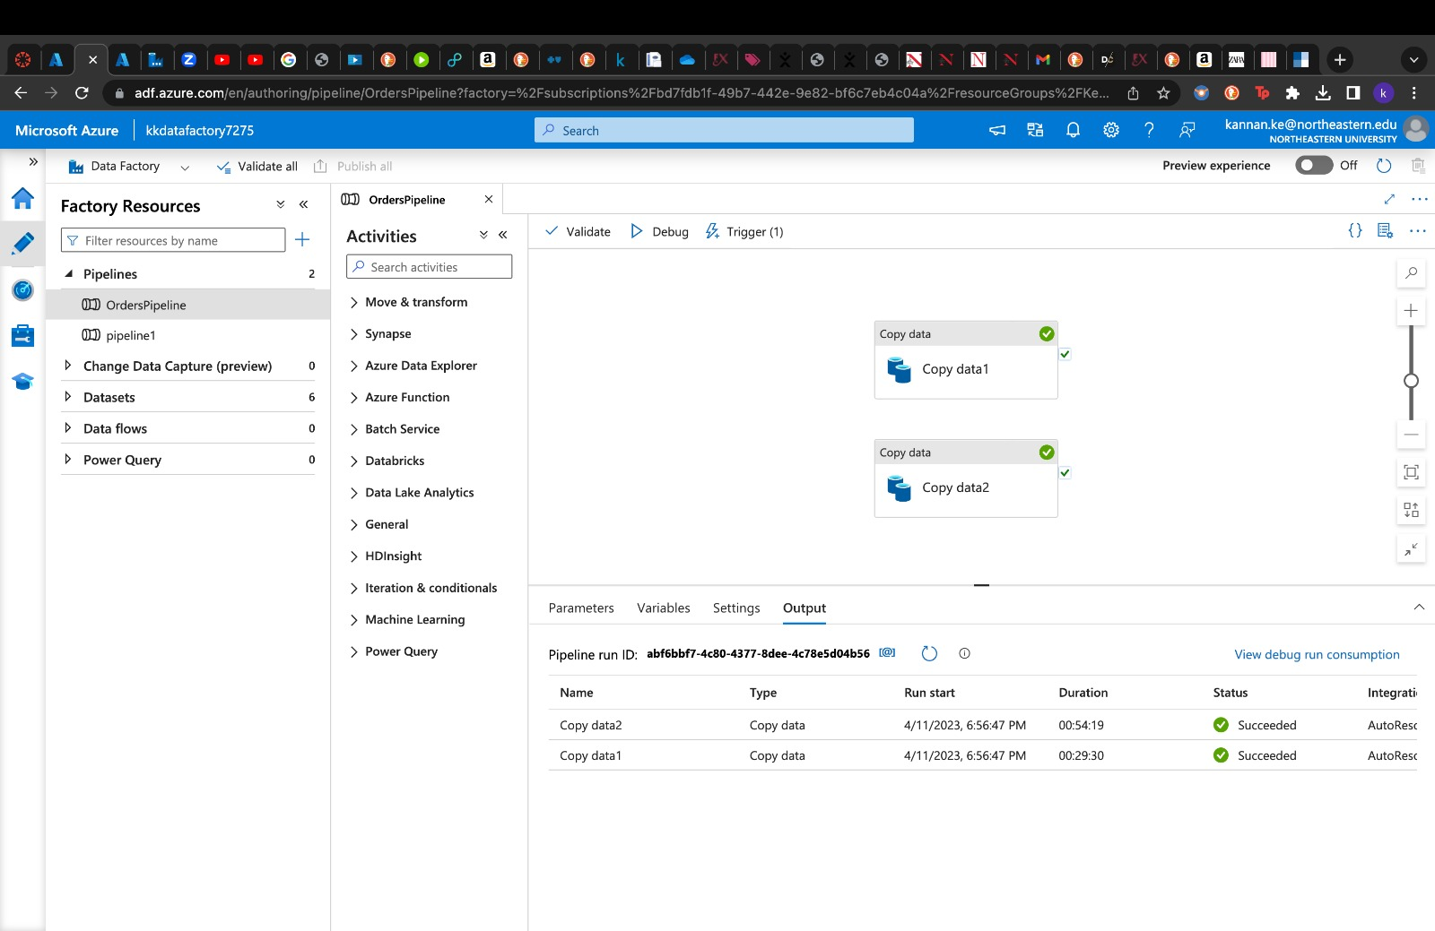
Complete Data Pipeline:
Integration and implementation of all data workflow components in the data pipeline.

Slide 10
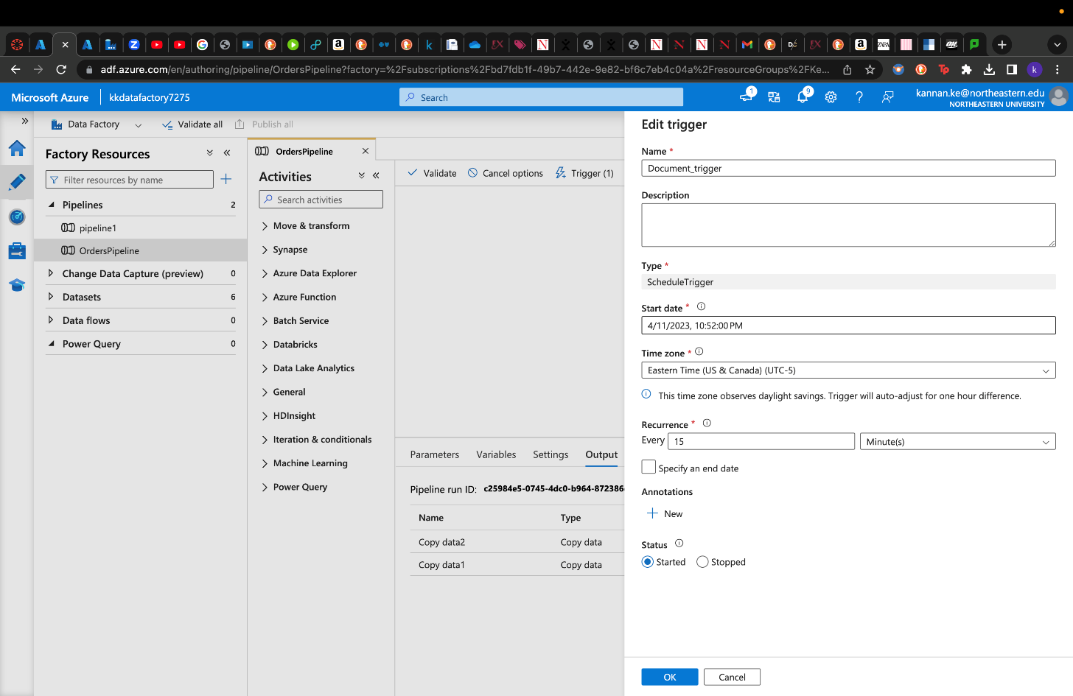
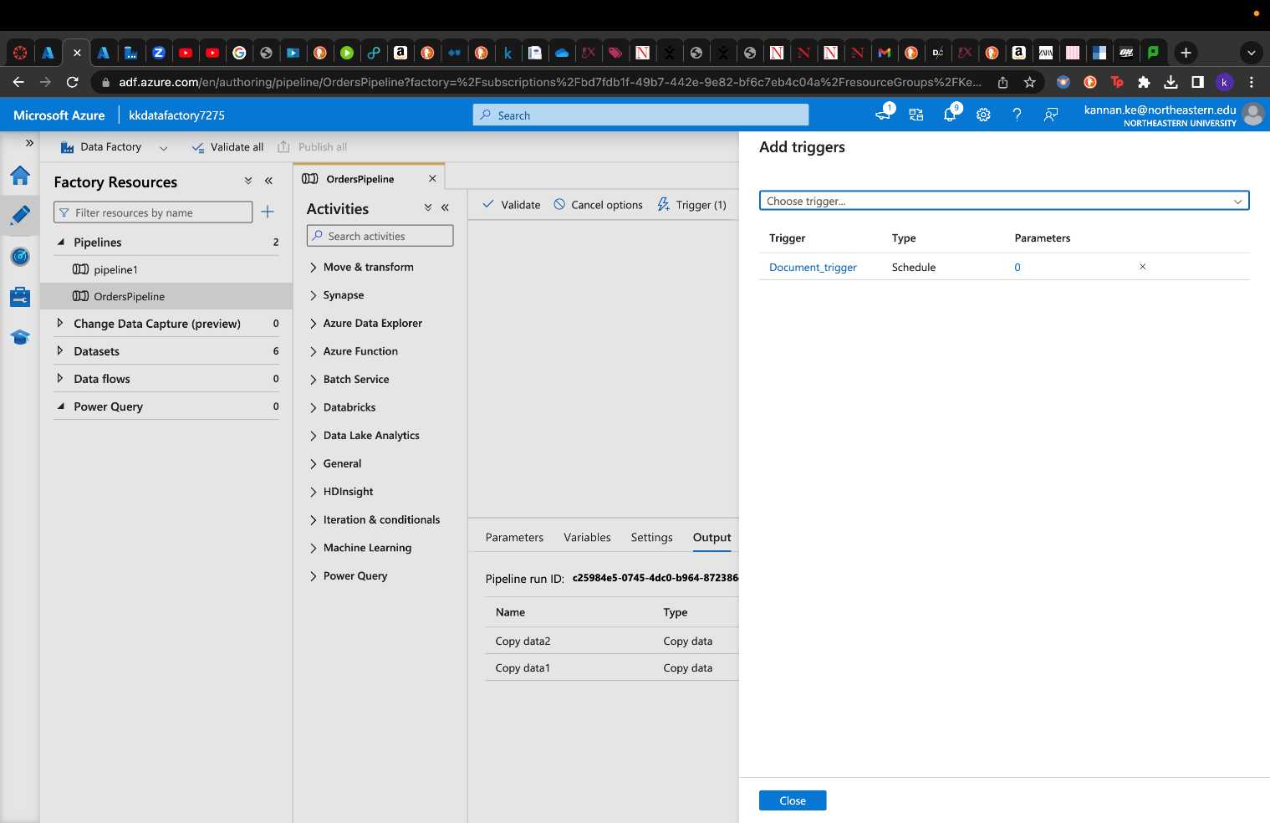
Data Refresh (Document):
HTTP trigger is used for document data update. The schedule is run every 15 minutes and thus the Cosmos DB document container gets updated with fresh records from the Blob storage.

Slide 11
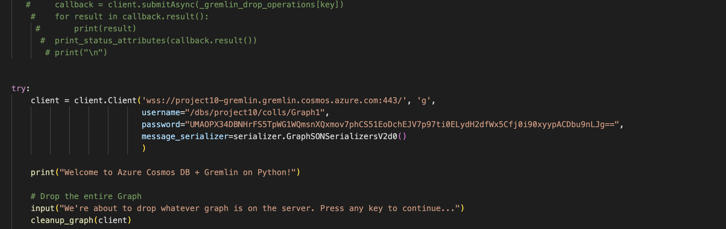
Graph Data Model Implementation:

Slide 12
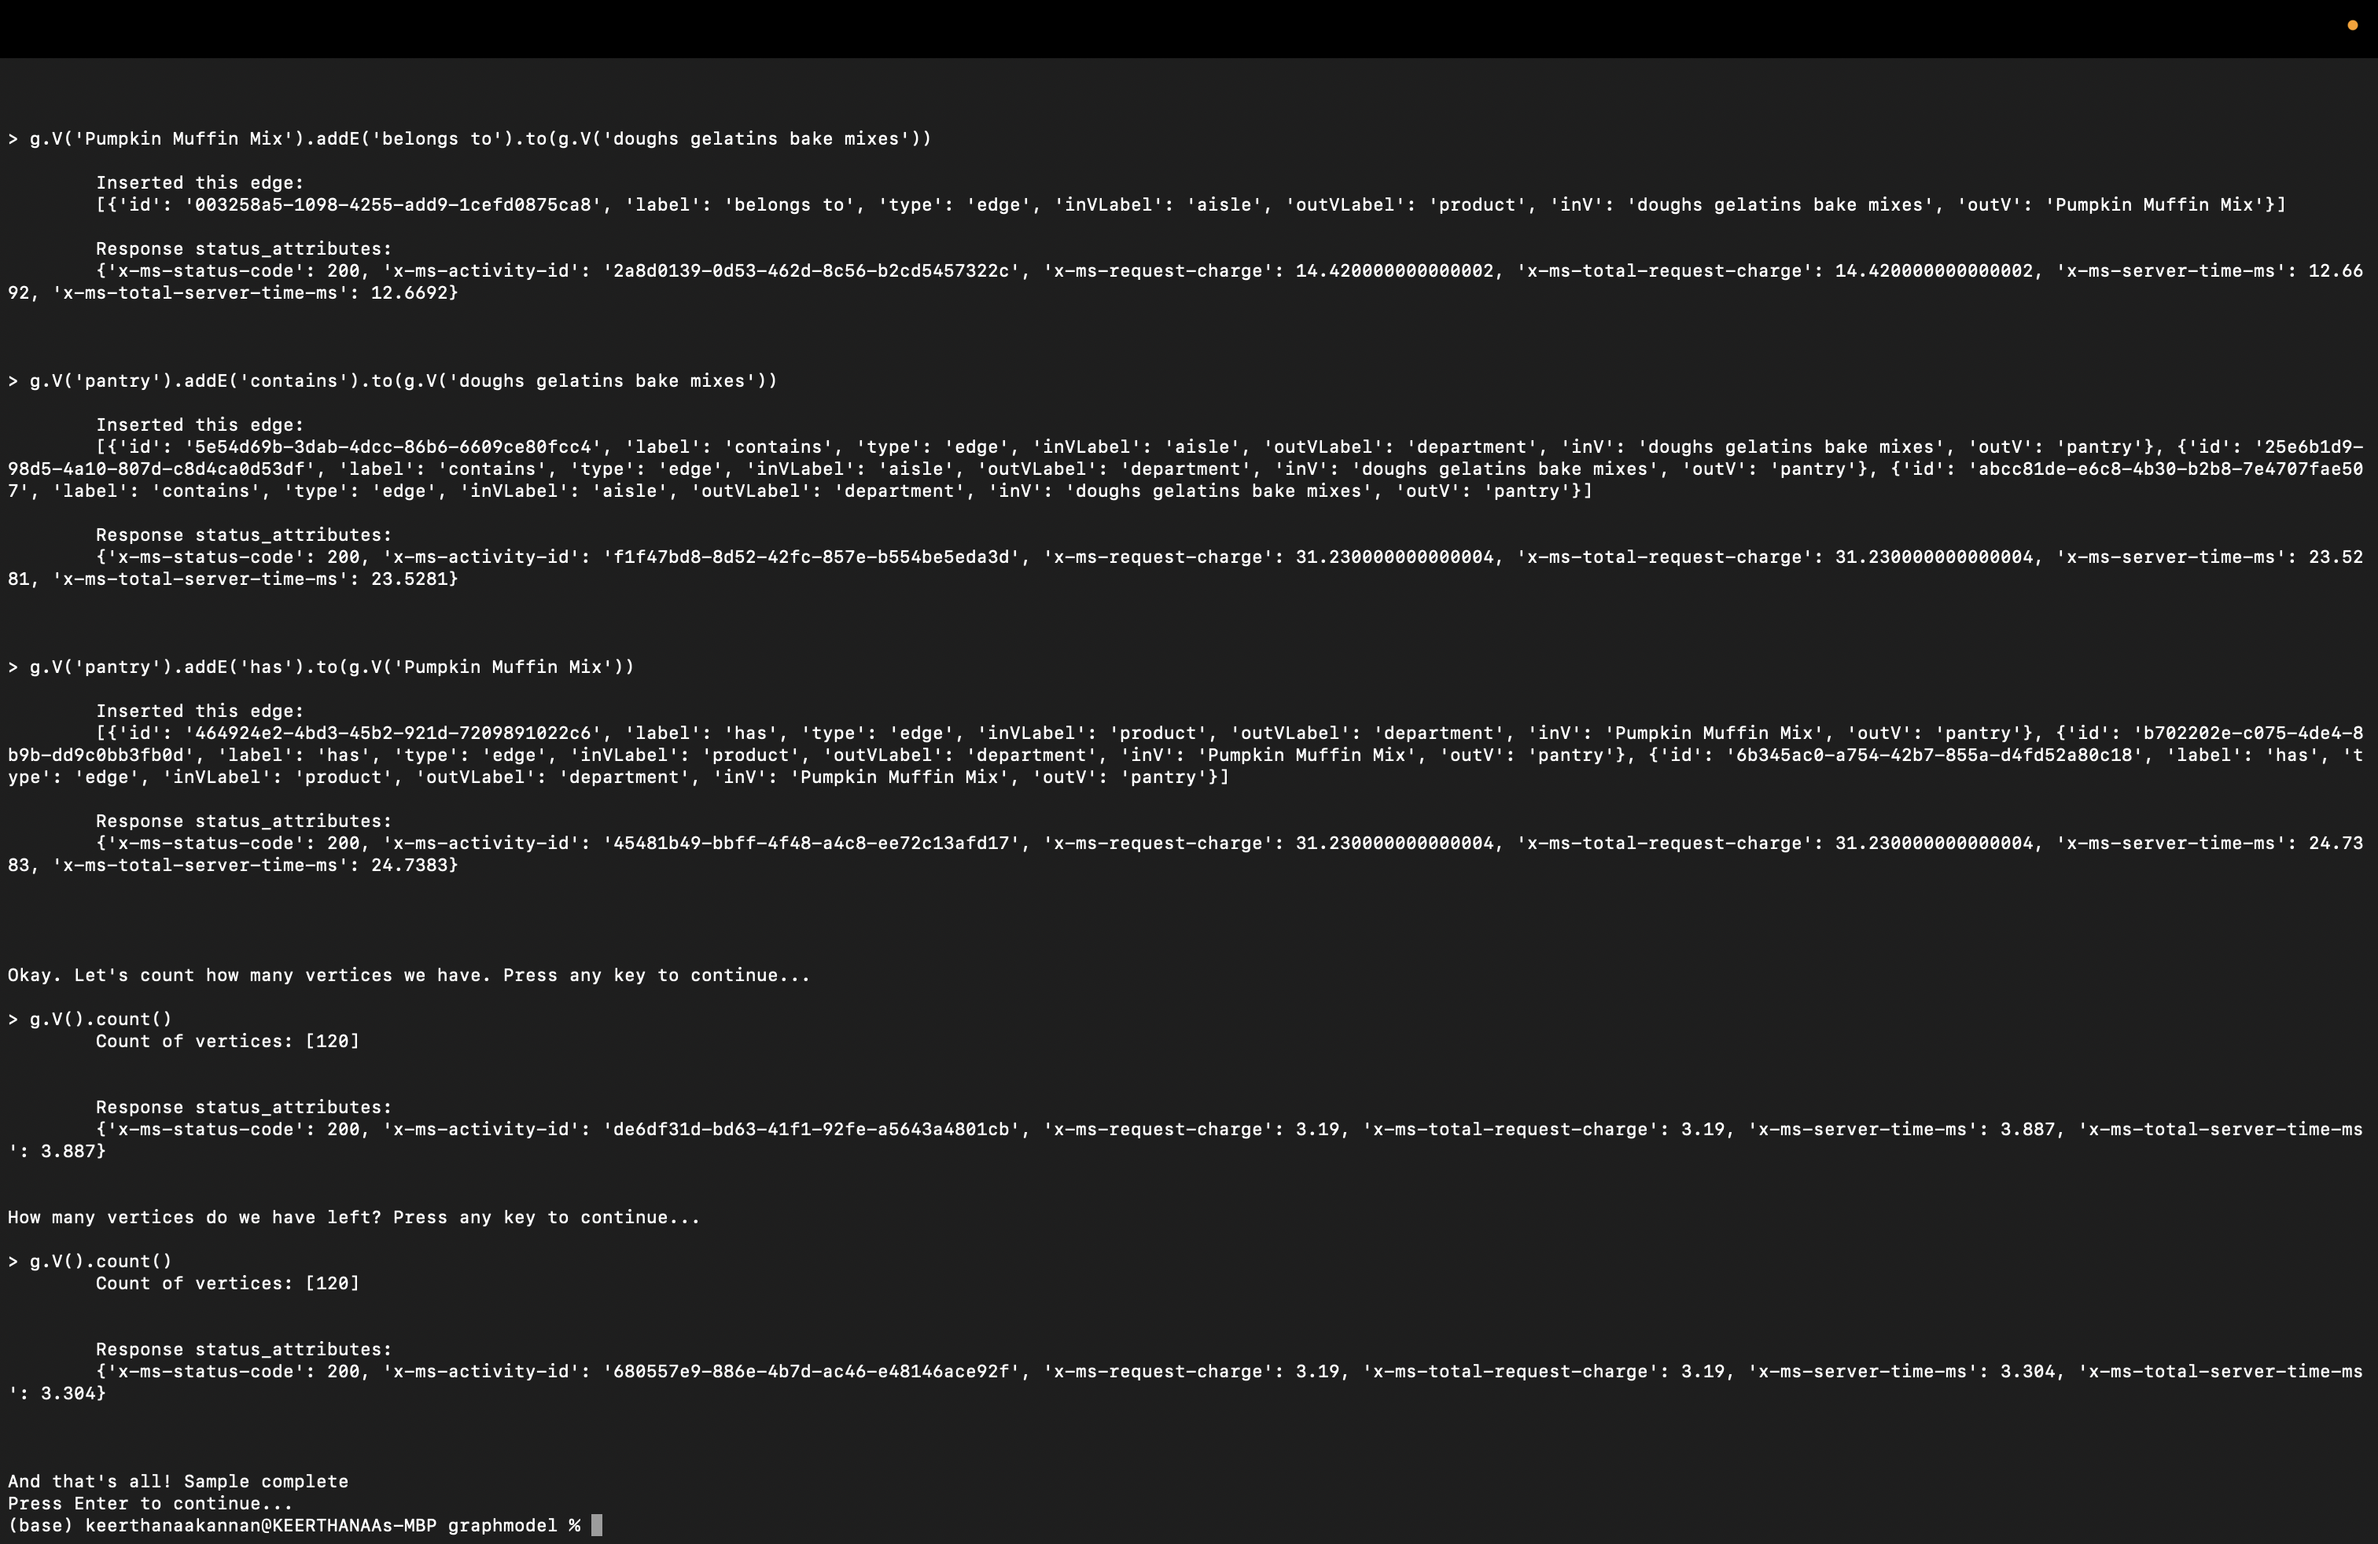

Slide 13
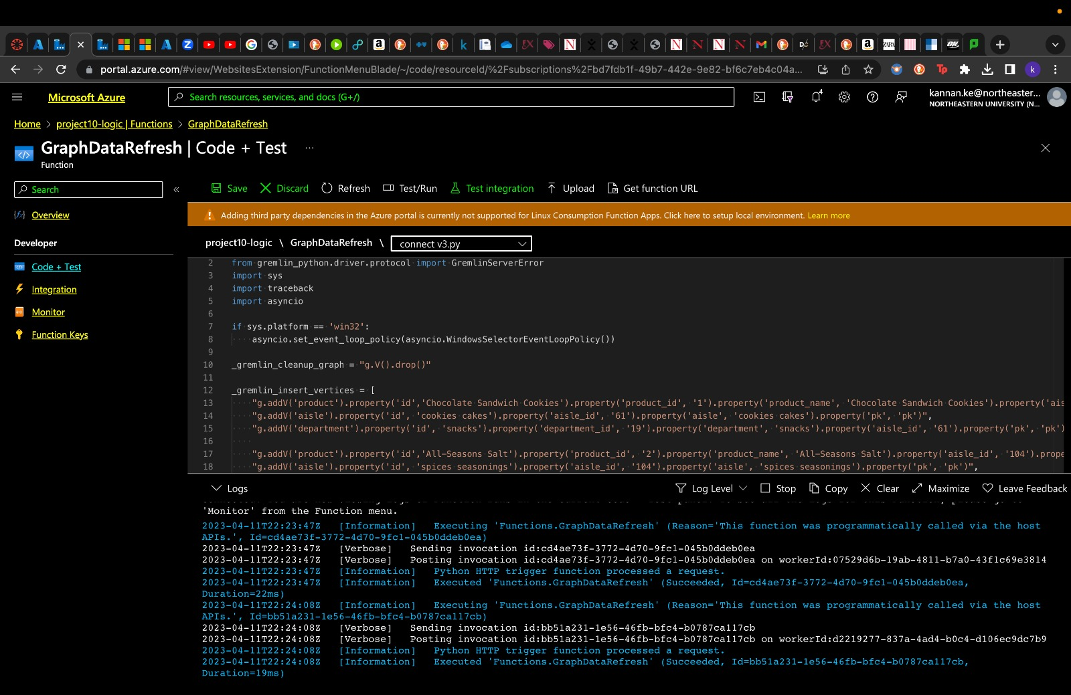
Data Refresh (Graph):
We make use of the connect.py python script to kickstart the auto data refresh for graph data model in Gremlin API.
Graph data refresh function created using Azure Logic Apps integrates our data across cloud services and on-premises systems. The input is Azure Blob Storage, and the output is set to Azure Cosmos DB.

Slide 14
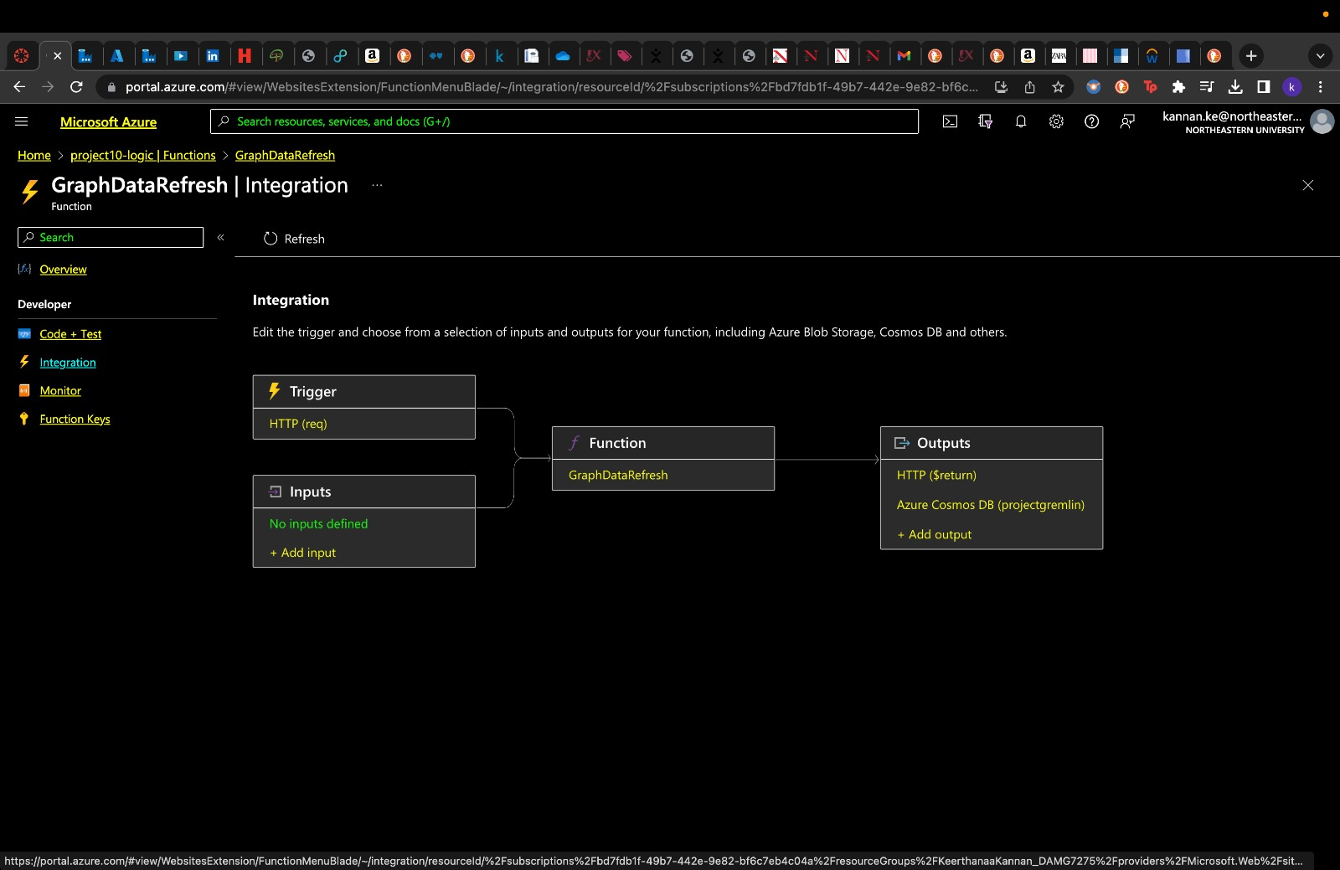

Slide 15
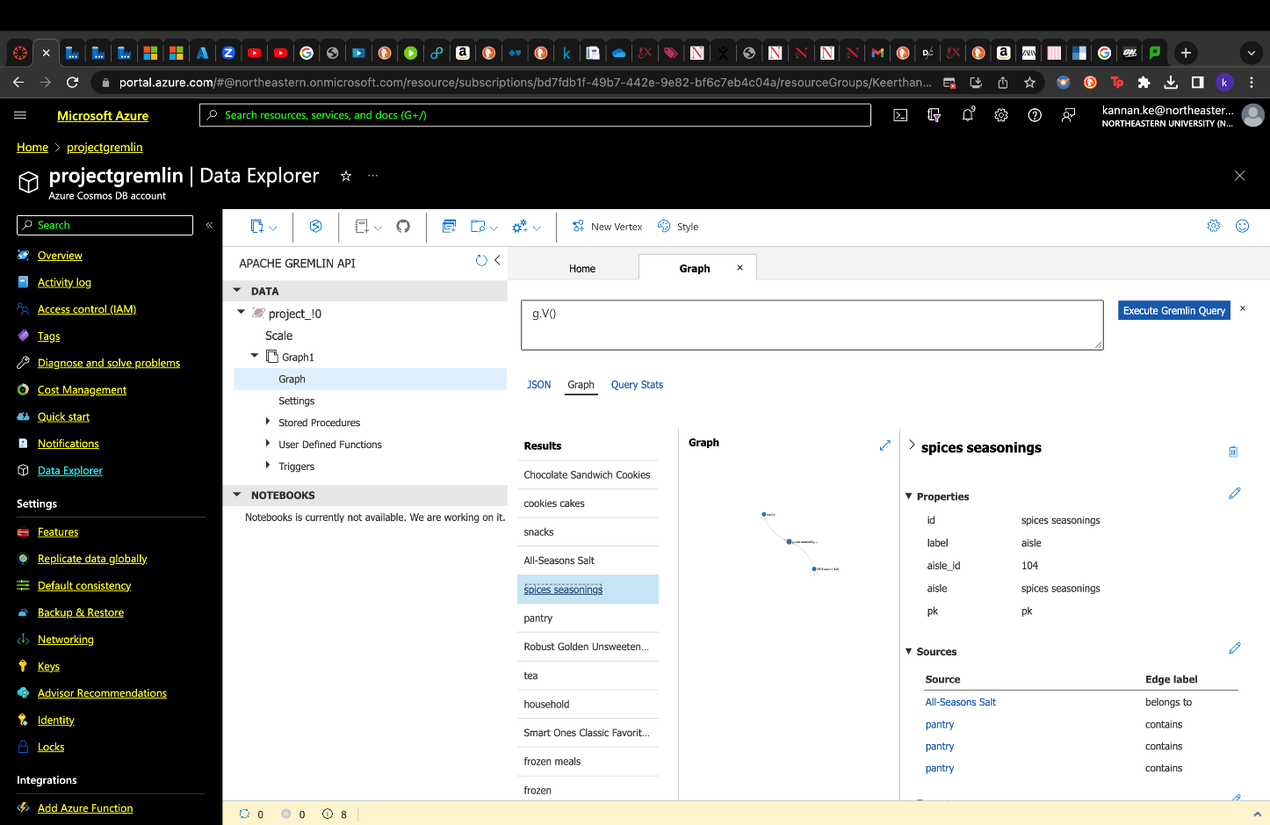
Data loaded into cosmos db gremlin API

Slide 16
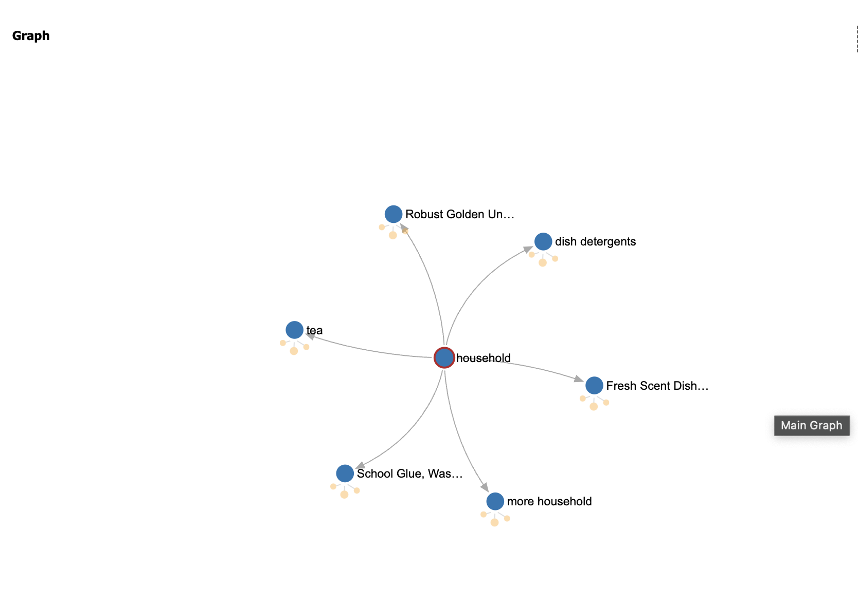
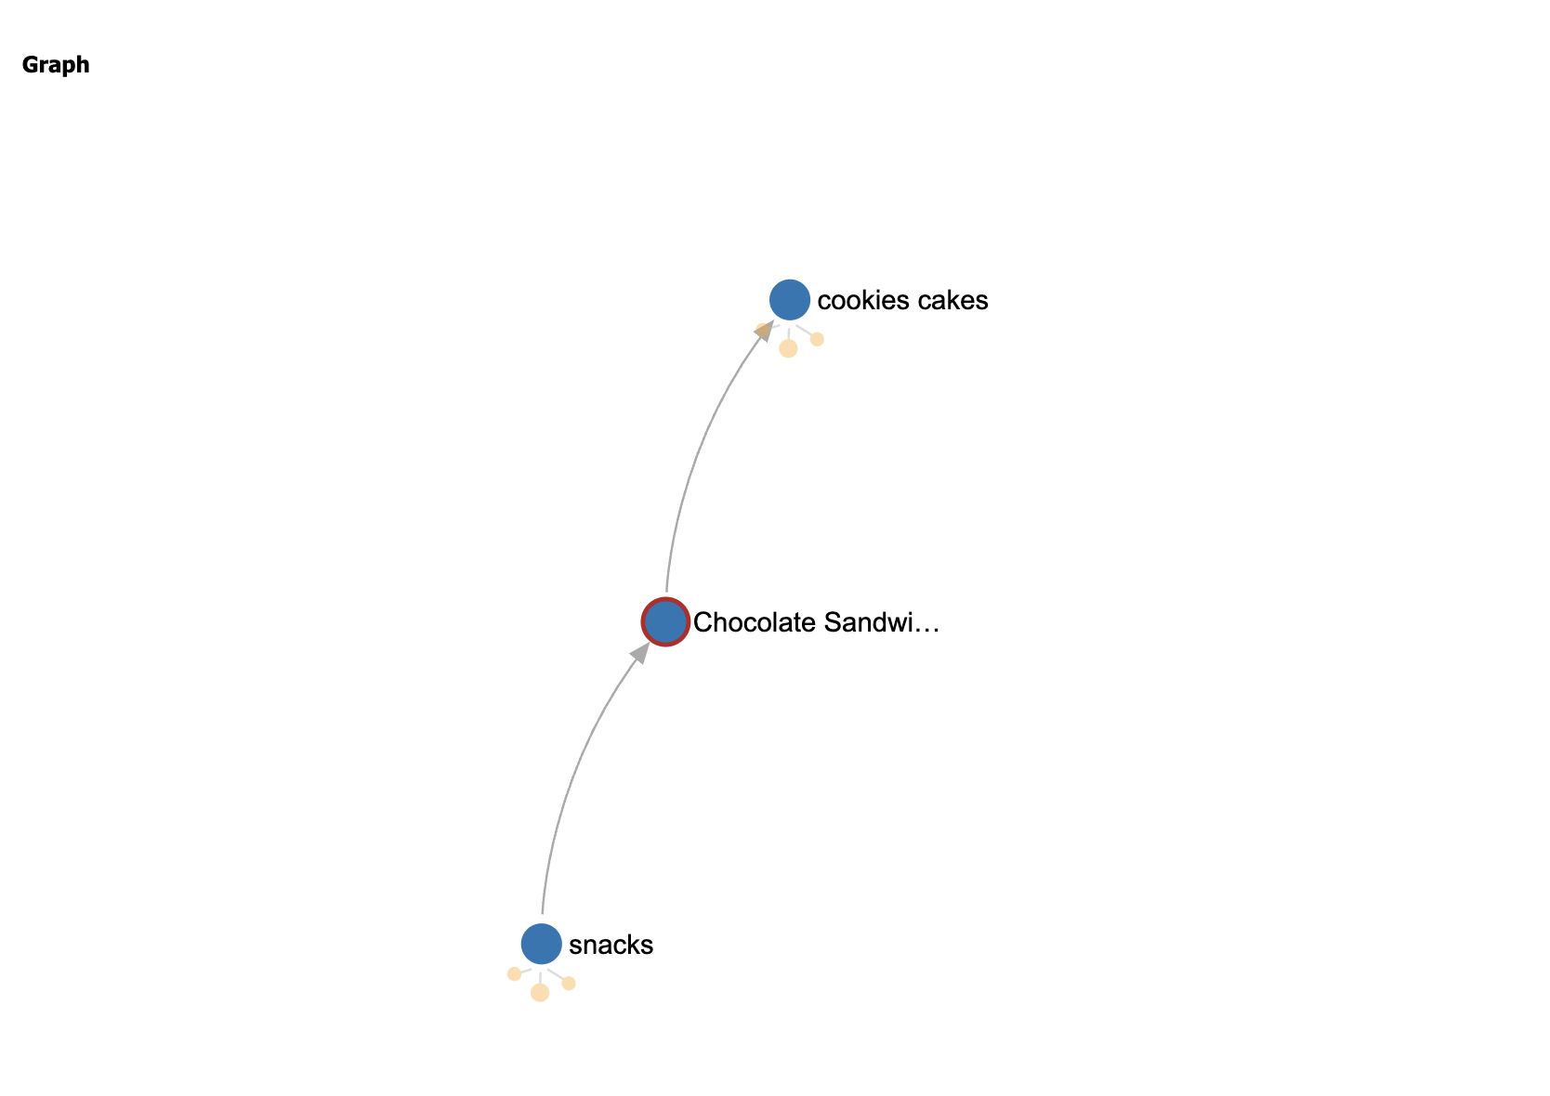
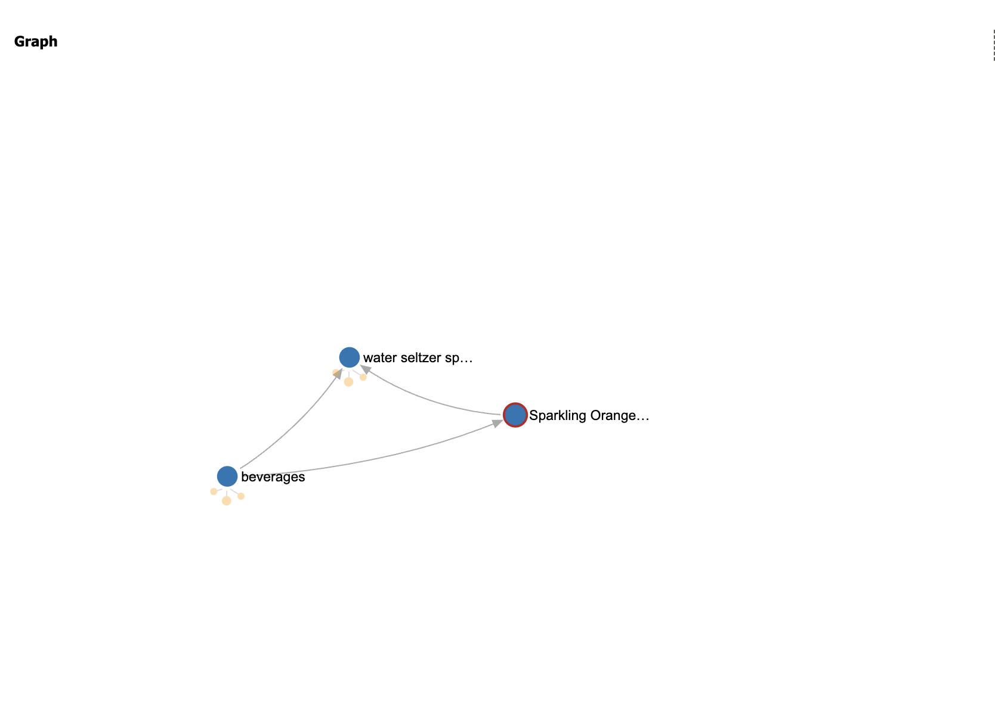
Graph data visualizations that we observed in Gremlin

Slide 17
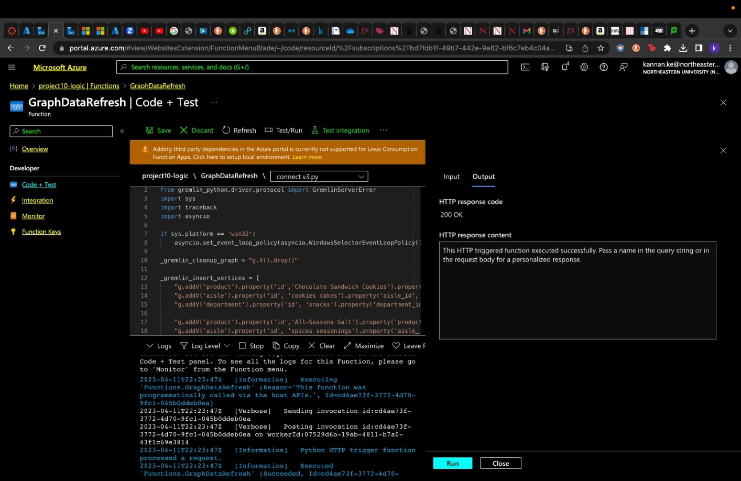
Data Refresh Code Test (Graph):
Code testing for the graph data model was successfully conducted and implemented.

Slide 18

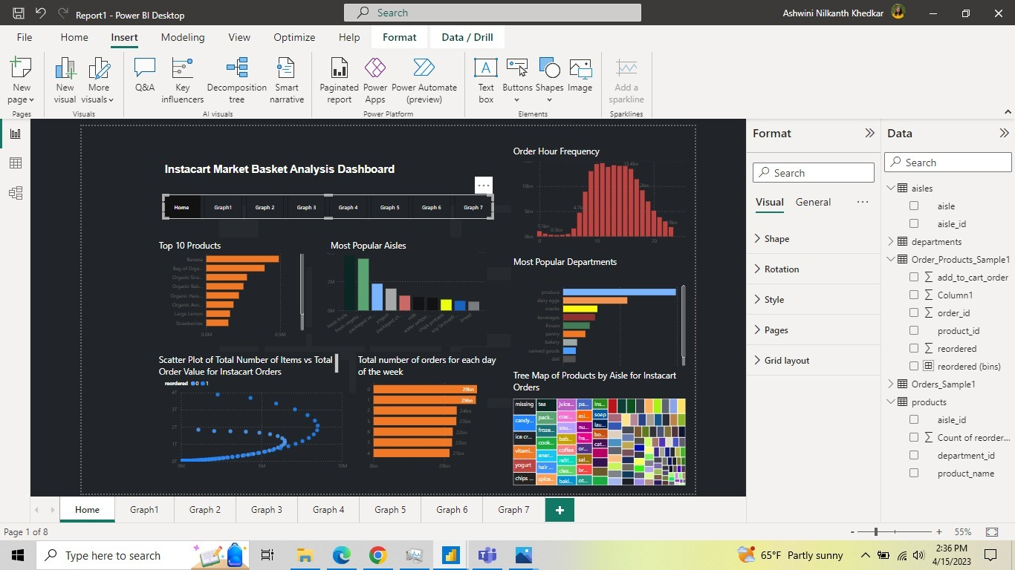
Visualizations:
Performed Visualizations and generated a dashboard using Power BI

Slide 19
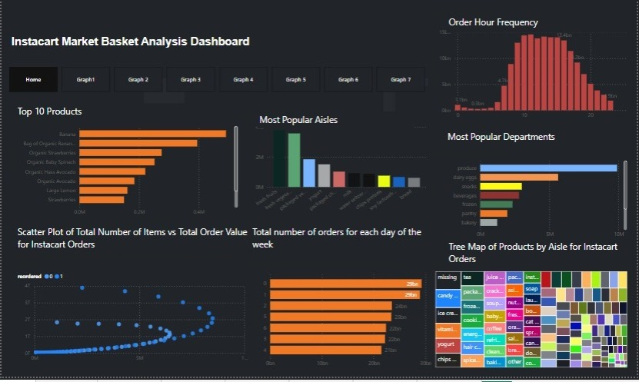
Dashboard

Slide 20
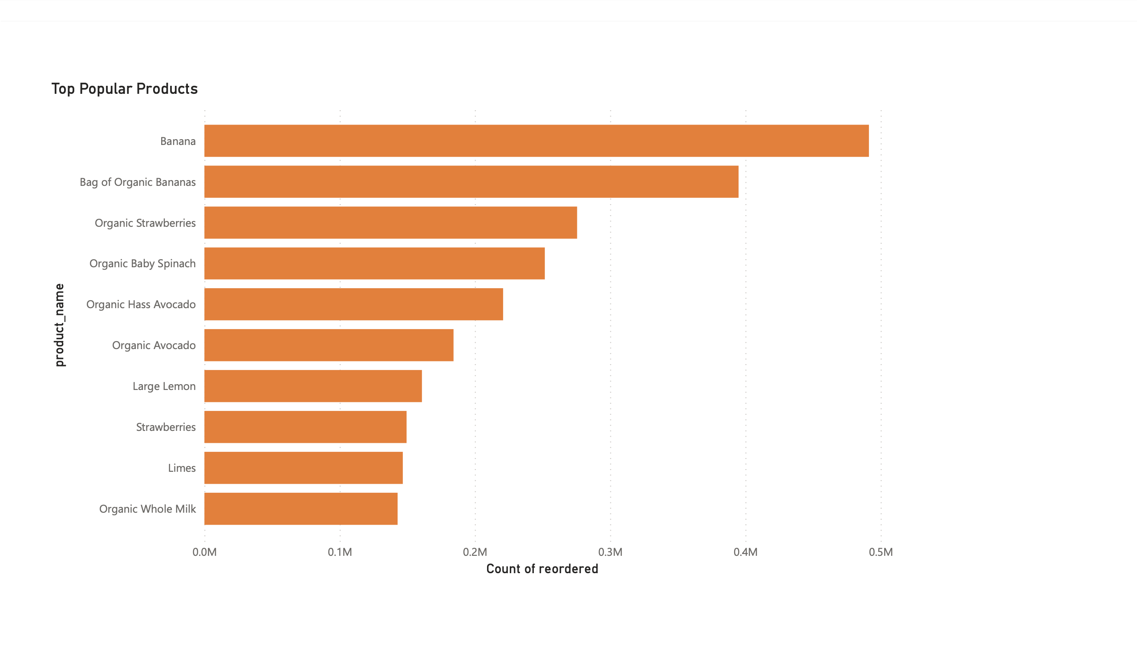
Individual Visualizations:

Slide 21
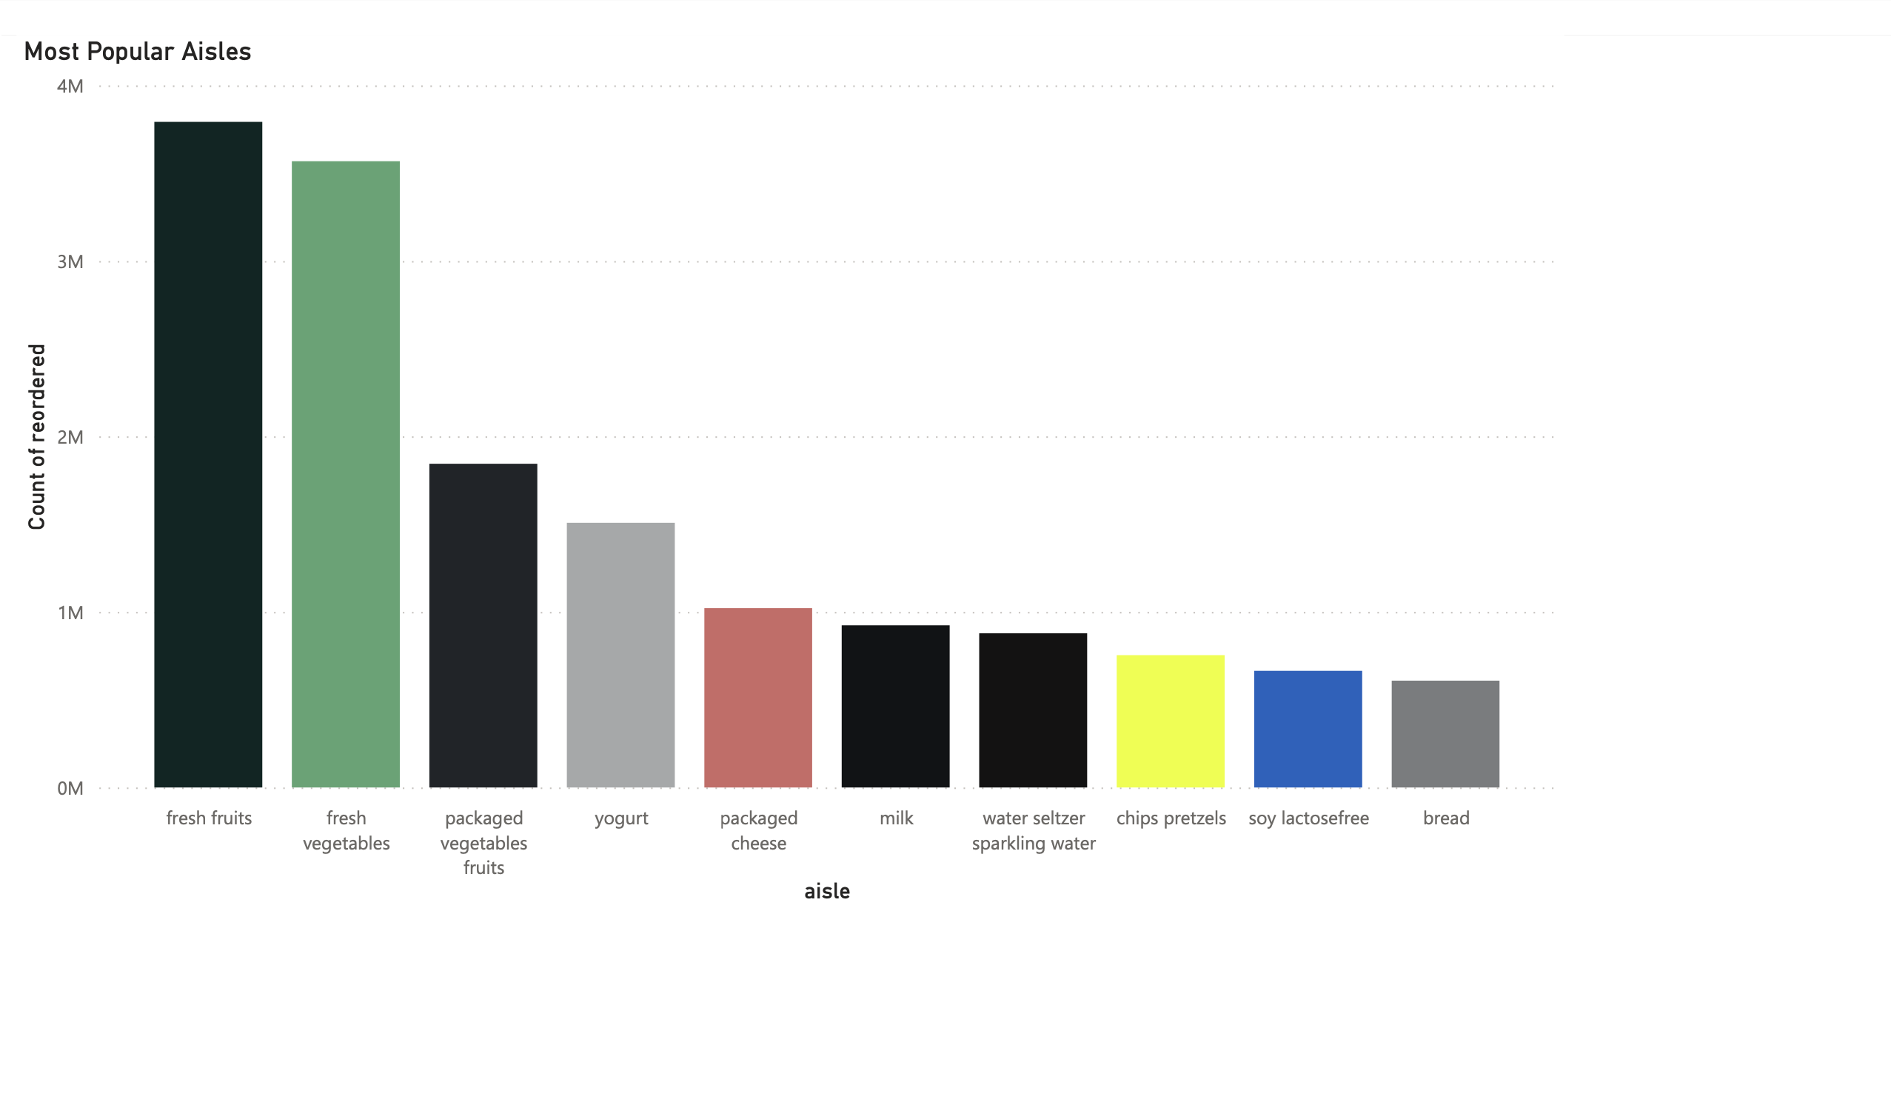

Slide 22
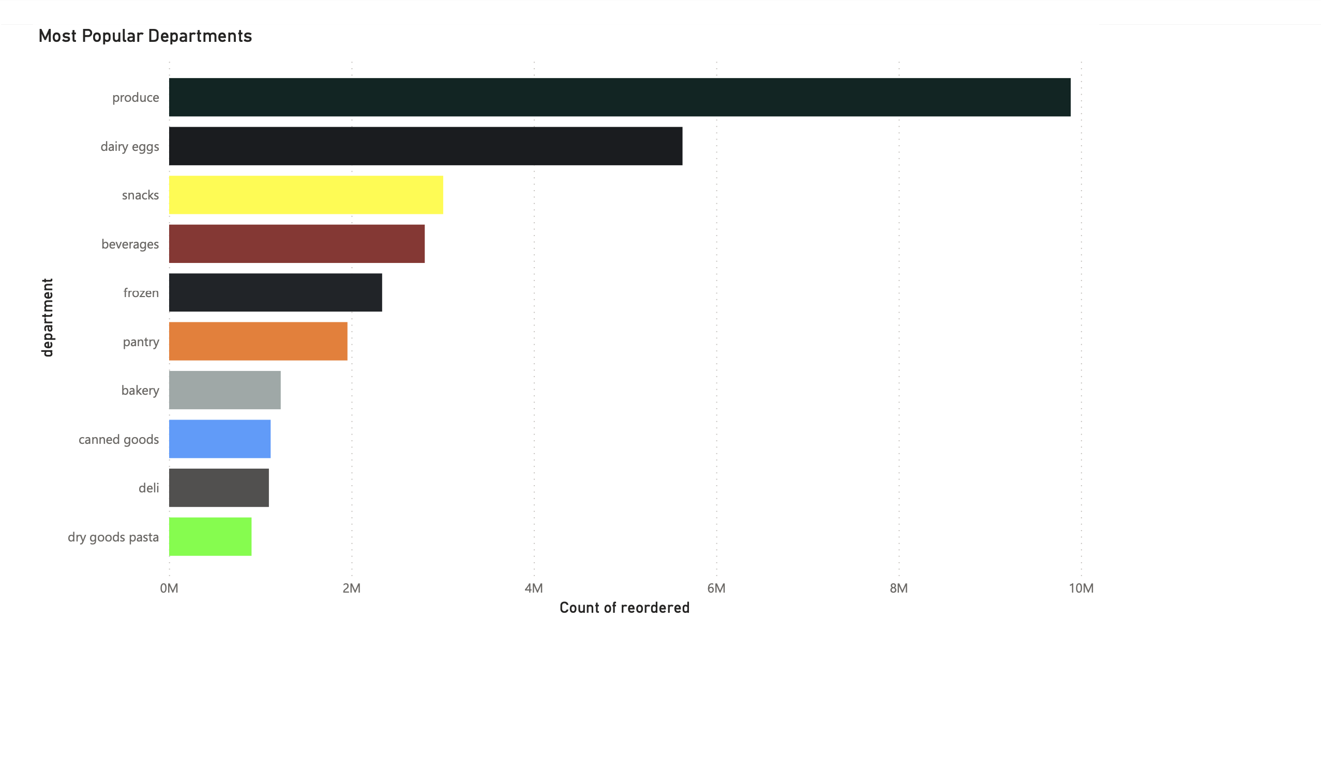

Slide 23
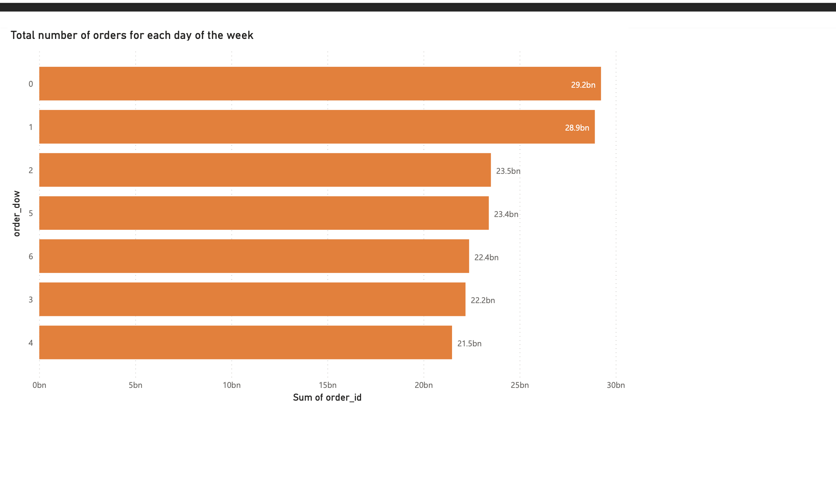

Slide 24
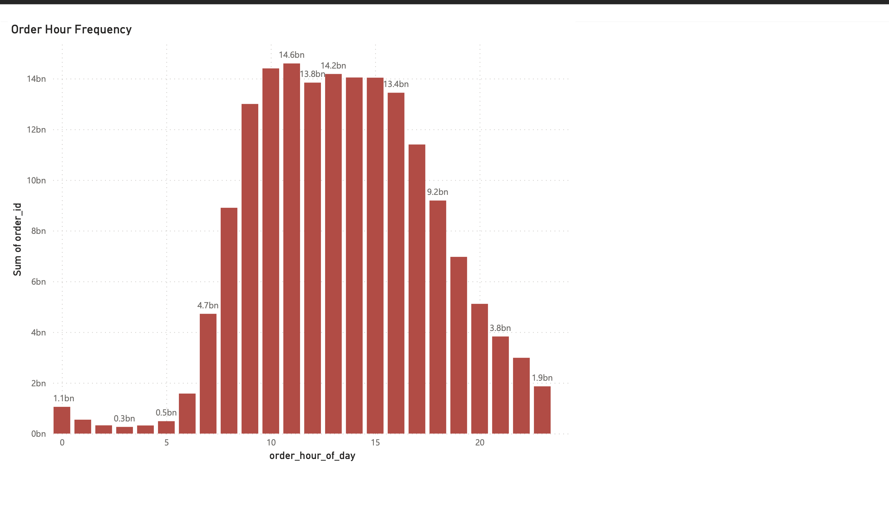

Slide 25
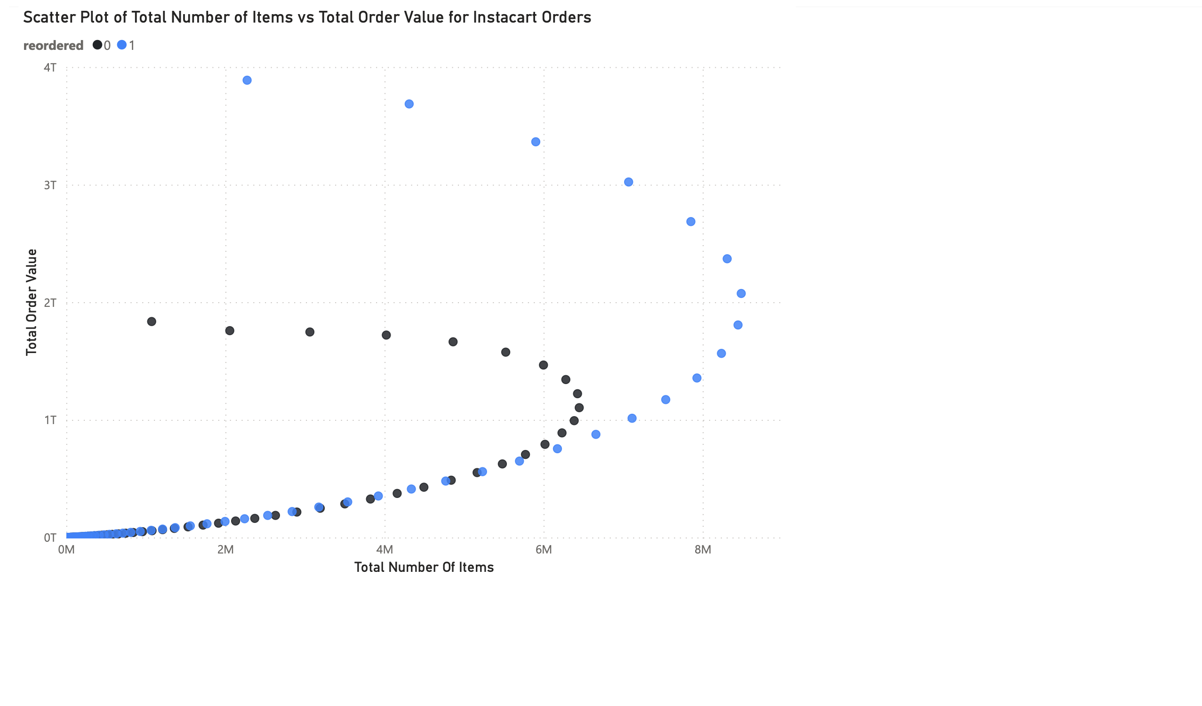

Slide 26
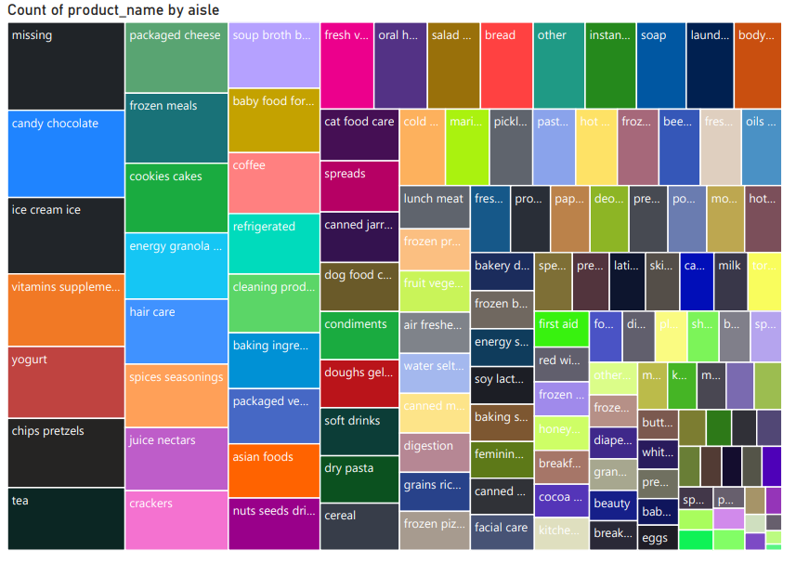

Slide 27
Future Scope:
Integration
Deployment
Integration of Document and Graph Data Models: Using Azure Synapse (exploring other options as well)
Model can be deployed in Azure Machine Learning as a web service which can be called using REST APIs.
Machine Learning
Application
Using dedicated SQL Pools to store, train, and test data to build ML models for better recommendations
A mobile app or web app can be built for such large-scale product recommendation and customer analysis

Slide 28

Questions?

